Slide 1
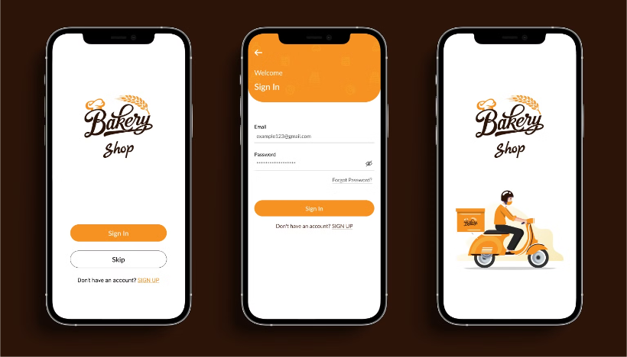
Online Bakery Bliss Delivery
Done by
M.prudhvi Guided by:
M.vamsi DR.Jayasakthi Velmurugan. D
K.Rupesh Reddy

Slide 2

Introducing Our Online Cake Ordering Website
Convenience at Your Fingertips: With our online cake ordering website, customers can now browse, customize, and order their favorite cakes from the comfort of their own home. No need to visit the store – just a few clicks, and your perfect cake is on its way!
Fast and Reliable Delivery: We understand the importance of timely delivery. Our website ensures that customers can schedule their deliveries to arrive exactly when needed, fresh and beautifully packaged.
User-Friendly Interface: The website is designed with simplicity in mind, making it easy for customers of all ages to navigate, view, and place orders without any hassle.

Slide 3
Responsive Design for Seamless User Experience
Desktop
Mobile
Tablet
Our website adapts perfectly to various screen sizes, including desktop, ensuring a comfortable and intuitive experience.
Our website is fully optimized for mobile devices, providing a streamlined and responsive experience for users on the go.
The website's layout adjusts seamlessly for tablet users, offering a clear and easy-to-navigate interface.

Slide 4
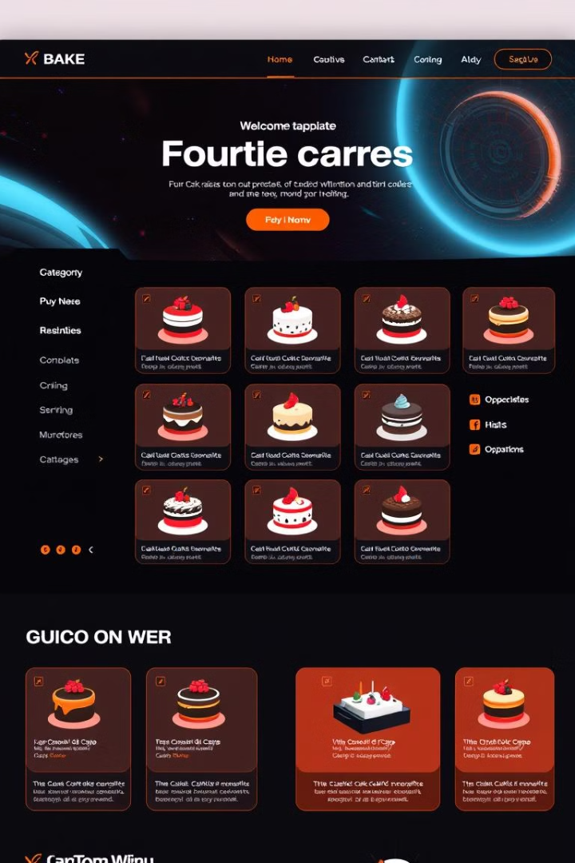



Intuitive Navigation and Easy Product Selection
Browse Categories
Explore our wide selection of cakes, categorized by occasion, flavor, and style.
View Details
Each cake features detailed descriptions, images, and pricing information for informed choices.
Customize Your Cake
Adjust sizes, flavors, fillings, decorations, and messages to personalize your cake.

Slide 5
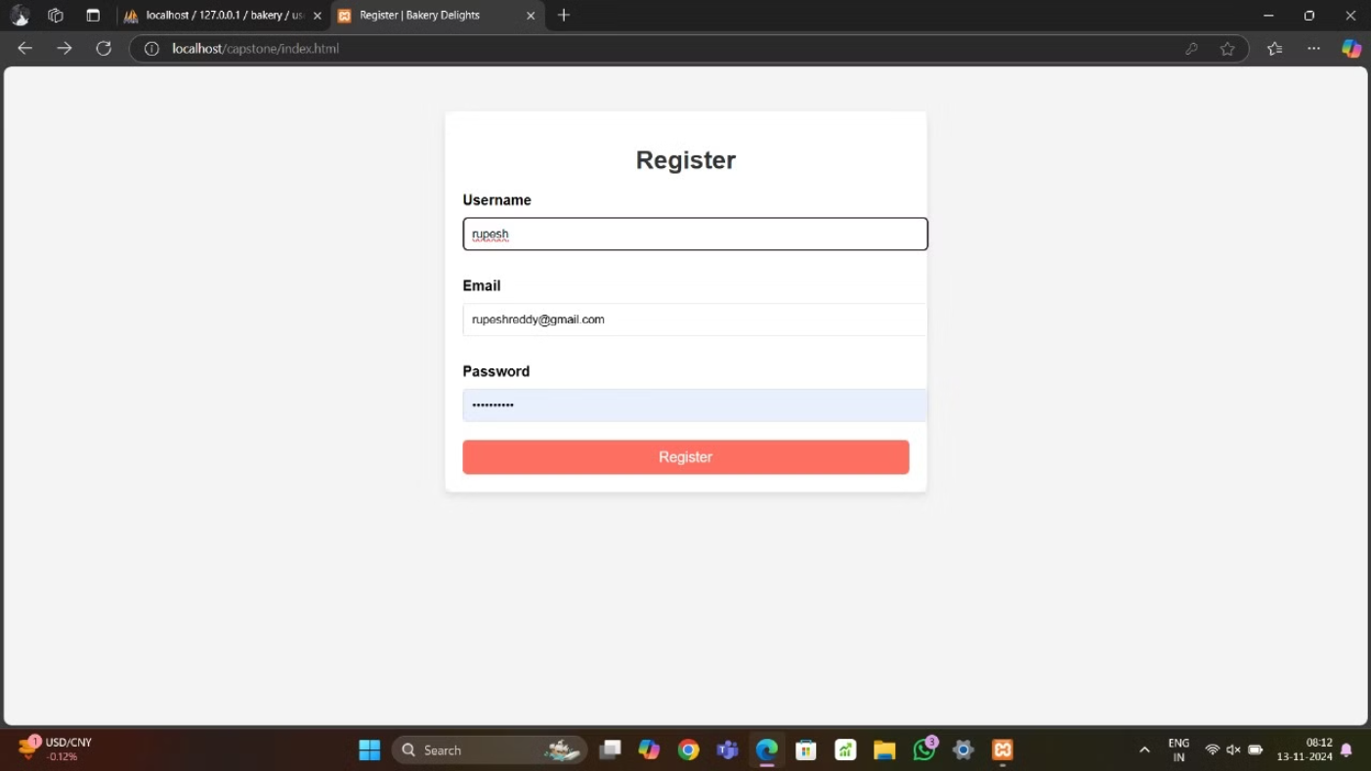

Slide 6
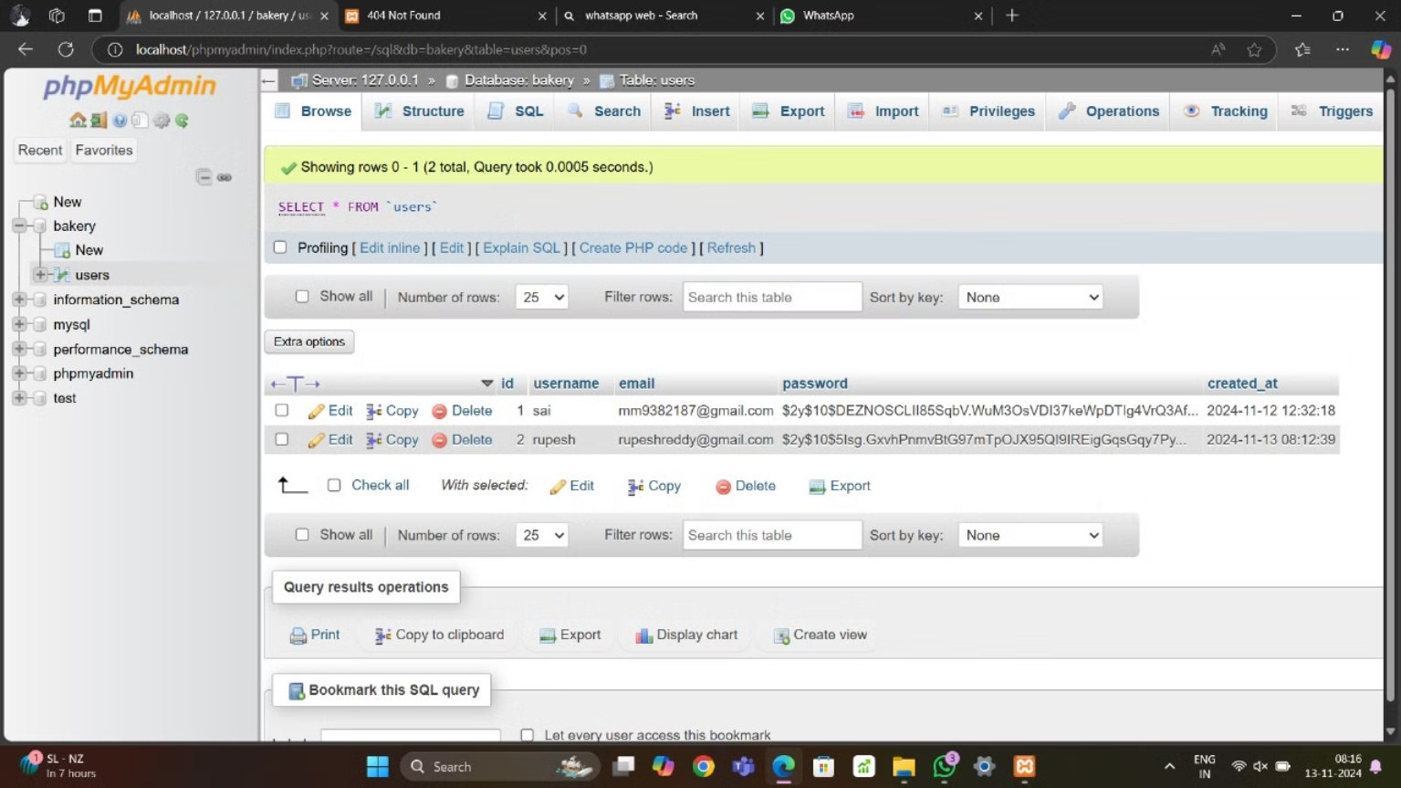
database

Slide 7
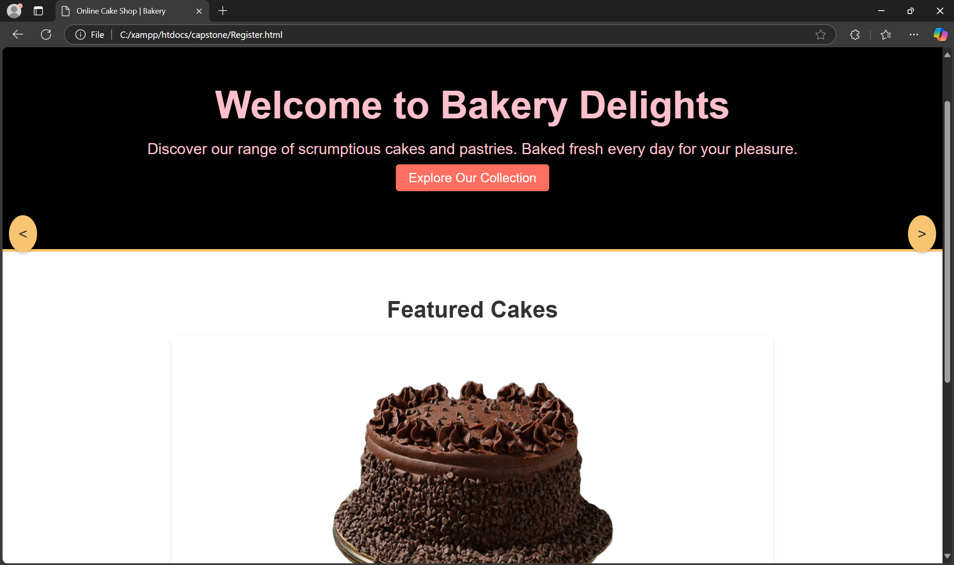

Slide 8

Secure Payment Processing and Order Tracking
Secure Transactions
Order Confirmation
Our platform uses industry-standard encryption protocols to safeguard your payment information.
You'll receive instant confirmation of your order with a unique tracking number.
Real-Time Updates
Track your order's progress from placement to delivery, ensuring transparency throughout the process.

Slide 9
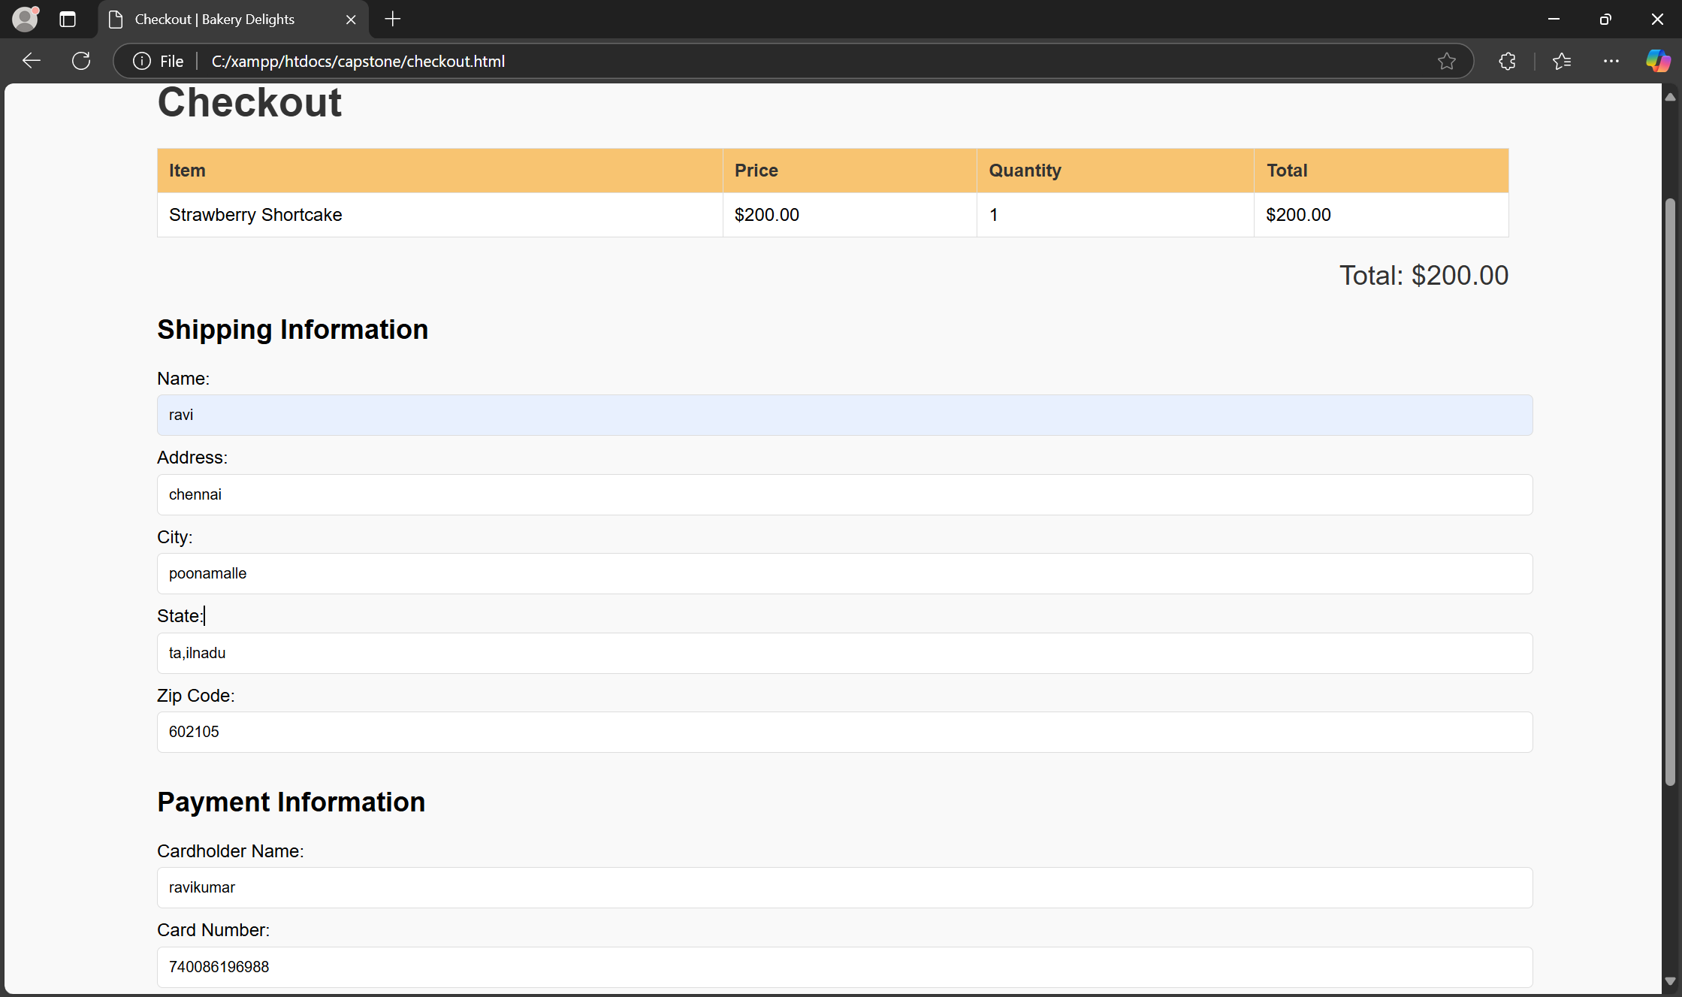
payment transactions

Slide 10
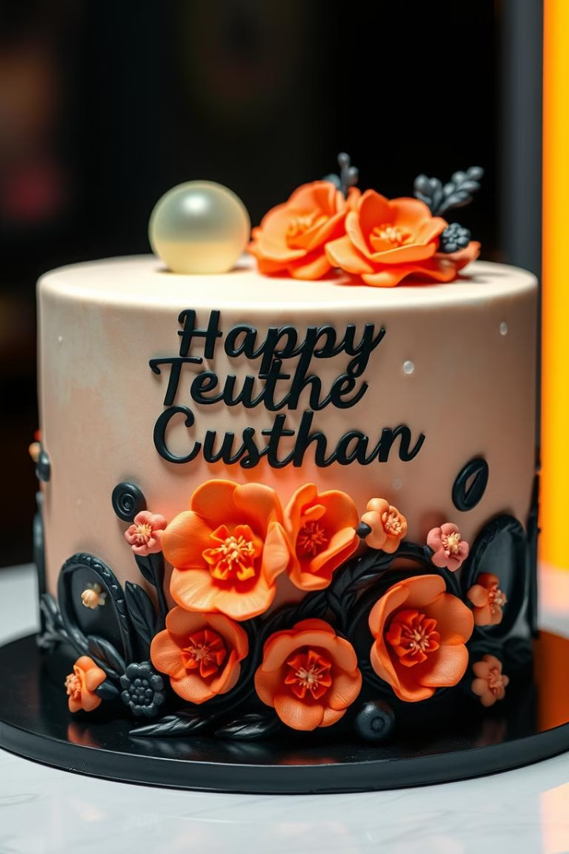
Personalization and Custom Cake Options
1
Choose Your Flavor
2
Custom Decorations
Select from a variety of classic and unique cake flavors, from chocolate to vanilla to fruit-filled.
Add personalized touches with custom designs, fondant figurines, and edible flowers.
3
Special Requests
Let us know your specific dietary needs or preferences, and we'll accommodate them whenever possible.

Slide 11
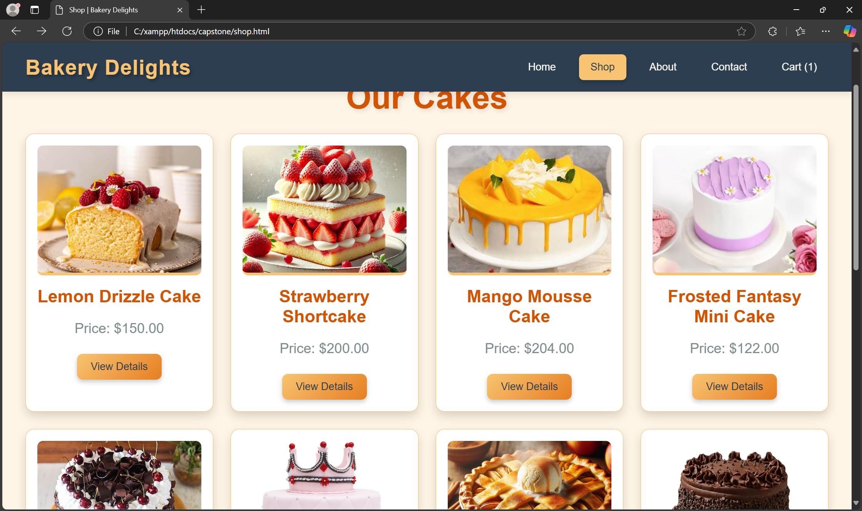
selecting Flavours

Slide 12

Efficient Order Fulfillment and Delivery
1
Order Processing
Our team carefully prepares your cake according to your specifications.
2
Quality Check
Each cake undergoes a meticulous quality check before being packed for delivery.
3
Delivery
Your cake will be delivered fresh and on time, ensuring a delightful experience.

Slide 13
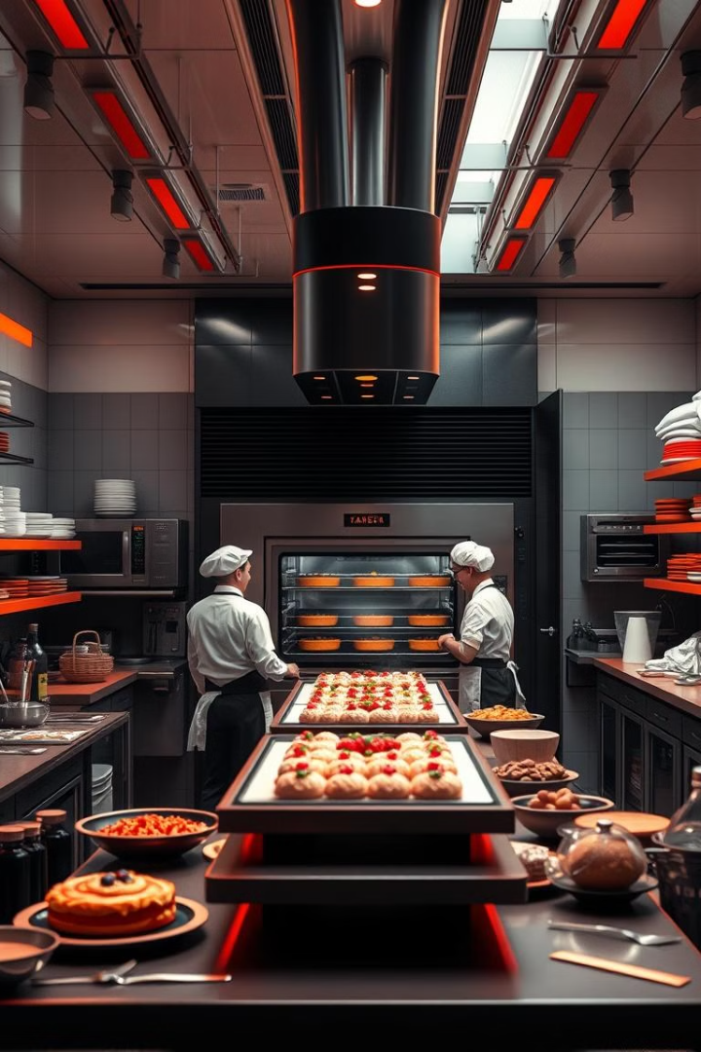
Bakery Management and Inventory Control
Ingredient Management
Track inventory levels to ensure timely restocking of essential ingredients.
Order Tracking
Monitor order status, production progress, and delivery schedules for efficient operation.
Quality Control
Maintain a consistent level of quality and freshness for all cakes produced.

Slide 14




Future Enhancements and Growth Strategies
Mobile App Development
Expanded Delivery Options
Loyalty Programs
Developing a dedicated mobile app for convenient on-the-go ordering.
Exploring partnerships with delivery services to broaden our reach and customer base.
Introducing loyalty programs with rewards and incentives to retain customers.

Slide 15


